Slide 1
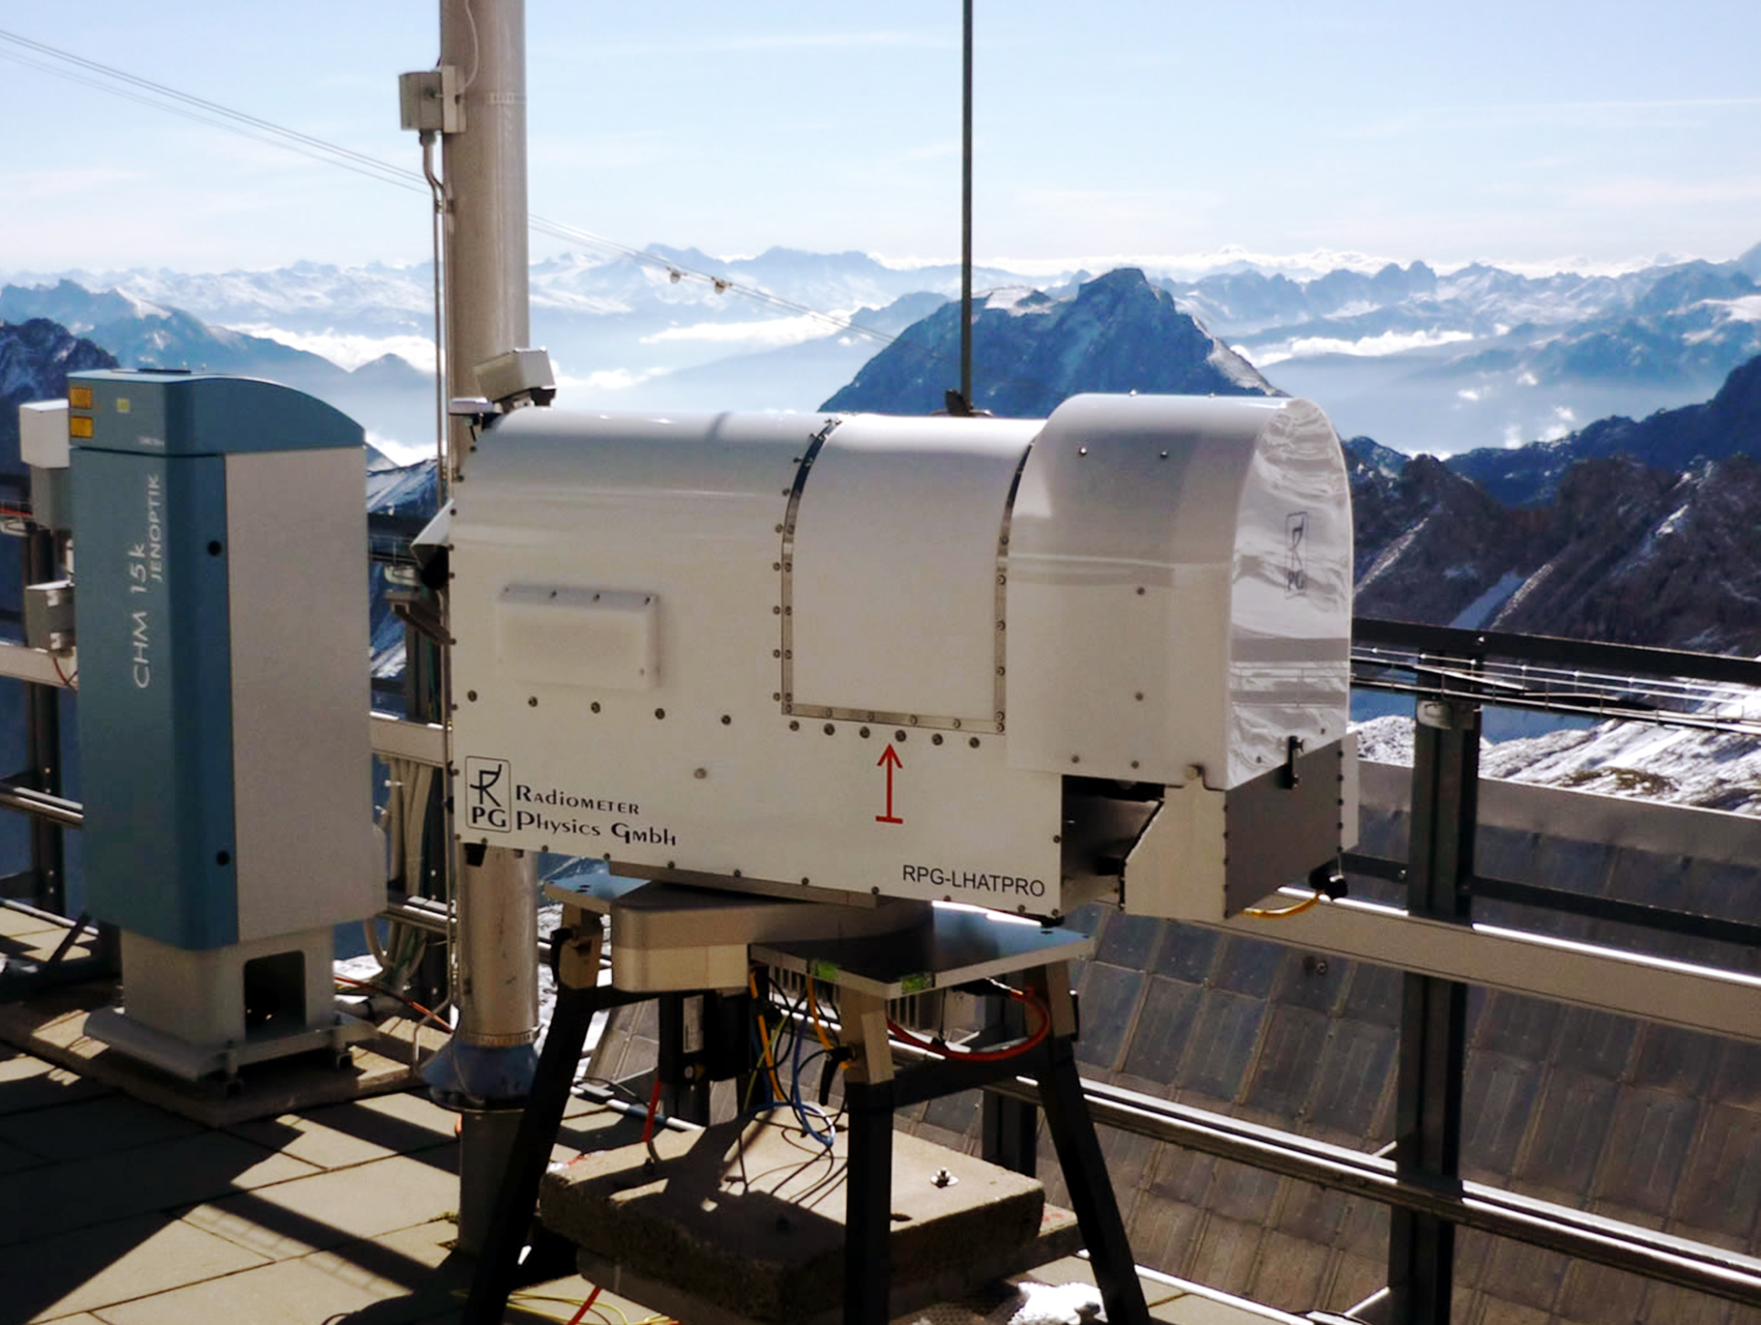

Microwave Radiometry for Atmospheric Remote Sensing
Harald Czekala, Thomas Rose, Gerrit Maschwitz
RPG Radiometer Physics GmbH, Meckenheim, Germany

Slide 2
Topics in the next 15 minutes…
Intro
Nature/Source of observed signal (thermal radiation, TB)
  Planck‘s law
  Conversion of energy units to brightness temperature TB
Link between MW spectrum and atmospheric state
  Absoption lines, transmission windows, information content
Measurement devices, radiometer technology
  Heteroydyne + Direct Detection
  Calibration
Retrieval of atmospheric data from microwave data
  Formulation of the problem – Simulation of the MW data by RTM
  Adding instrument imperfection – Regression or iterative
Examples…

Slide 3


Remote Sensing: The general perspective
What is „Remote Sensing“?
Observing radiation (more general: energy) reaching a „receiver“ device to learn something about a remote object
  Examples:
  The human eye
  (binocular total power receiver, multi-pixel focal-plane array,
  recording of mostly back-scattered light in the 500 nm to 800 nm region…)
  Radar, Lidar, Sonar, Sodar, ….
  IR fever thermometer…
  Microwave specrometers
  Microwave radiometers
What are we focussing on? Microave Radiometry…
Passive total power radiometers in the centimer to millimeter wavelength regime (10 GHz to 300 GHz)
Retrieval algorithms to invert observed microwave sky brightness into something meteorological (meaningful) data

Slide 4
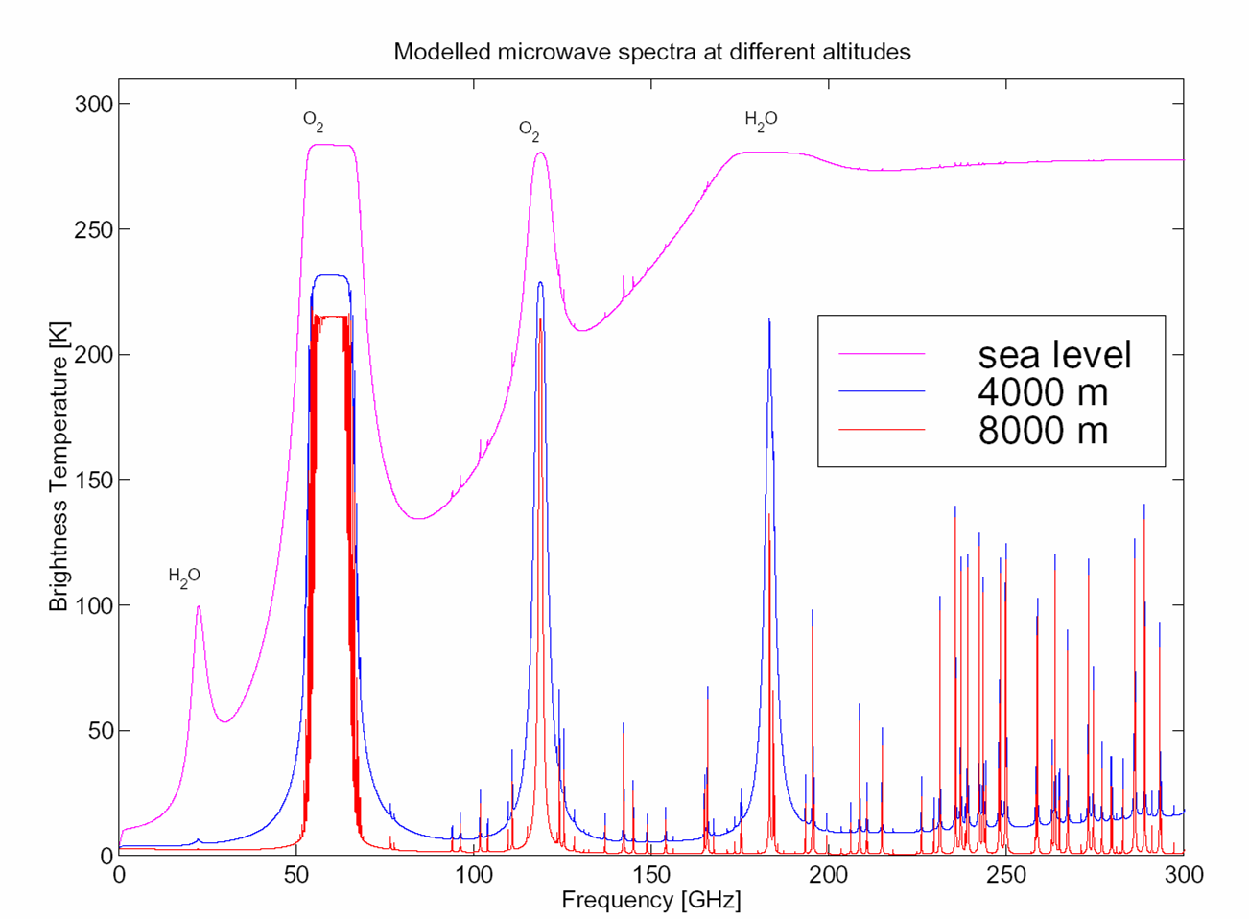
Basic Concept in one Slide
Passive: detection of microwave Thermal Radiation (no power emitted by MWR!)
  Emission (+absorption, scattering) from atmospheric components:
  Gases (H2O, O2, N2,… line emission)
  Hydrometeors (clouds, precipitation, frequency dependent continuum)
Radiometric observation:
Intensity (sky brightness) in units of
brightness temperatures (TB)
  At several fixed frequencies
  At several elevation angles
Meteorological Variables
Calculated by retrievals
  Solving the „forward problem“
  (radiative transfer for a given
  atmosphere)
  TB = F(T(z), Q(z), P(z), LWC(z))
  Inversion of F is the „retrieval“
  T(z) = F⁻¹(TB)
  Inversion problem is ill-posed
  Data set statistics important!

Slide 5
Navigation
2. Thermal Radiation and the Microwave Spectrum

Slide 6
Thermal Radiation: Planck‘s Law
Source of detected signal: Thermal radiation (Planck , 1901)
All bodies of with T>0 emit EM radiation at all wavelengths
B_{λ} spectral power density [W m⁻² sr⁻¹ m⁻¹]
h = 6 626⋅10⁻³⁴ J s Planck's constant
k_{B}= 1.38⋅10⁻²³ J/K Boltzmann const.
c = 2.99792⋅10⁸ m/s speed of light
B_{λ}(T) , 10⁷ W/(m²sr μm)
wavelength, λ

Slide 7
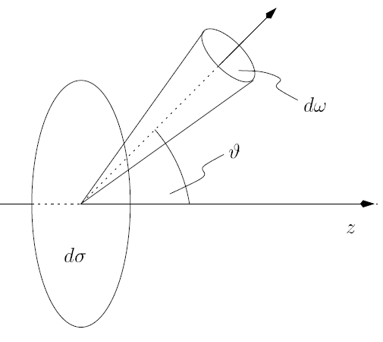

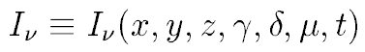

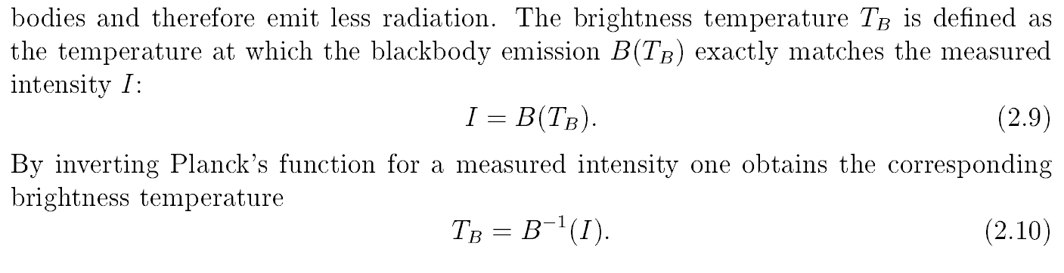
Observables: Intensity → Brightness Temperature
Radiometers observe „sky brightness“
or: radiant energy
or: specific intensity, …
Units:
Extremely small power levels: P=~10⁻¹³ W
(demands high amplification, 100 dB)
More „human readable“ units: Brightness Temperature (TB)
Optically thick (solid) objects have TB = ε·(T_{physical}) (with emissivity ε=0.0 …. 1.0)
Optically thin media: translucent, optical thickness τ
absorption & emission proportional to presence
of absorbing matter → RTM (Radiative Transfer Model)

Slide 8
Navigation
3. How the MW Spectrum is defined by the Atmosphere

Slide 9
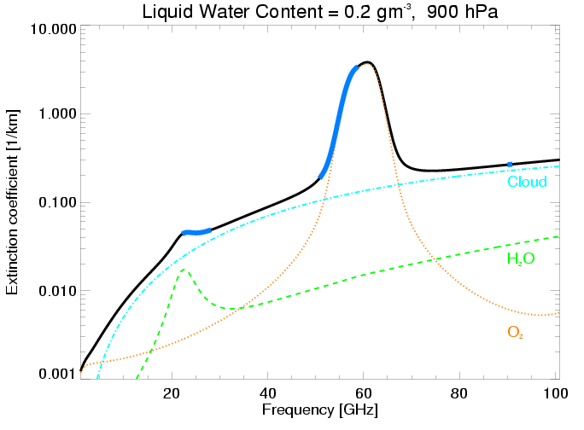
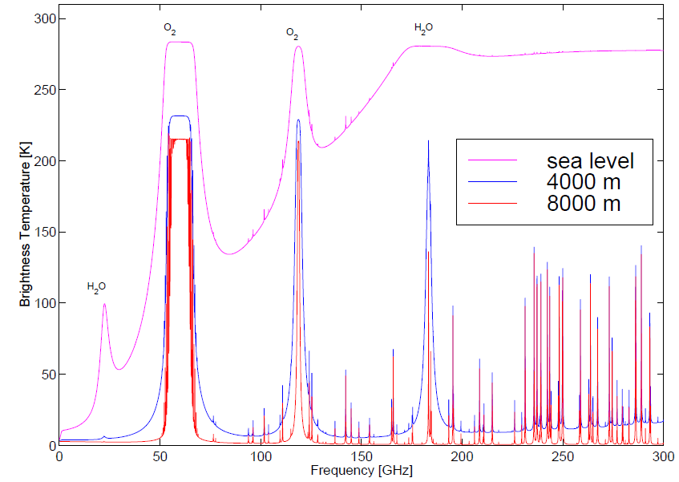
Impact of Atmosphere on MW Spectrum (I)
Emission proportional to absorption (Kirchhoff‘s radiation law)
Atmosphere is made from gas and small particles
➔ discrete absorption lines rather than continua (quantum mechanics)
Atmospheric constituents define the observed spectrum
Emission lines of water vapour (vary with H₂O Mixing ratio, and Temperature)
Emission lines of Oxygen (vary with T, but mixing ration is fixed)
Window channels in between lines: mostly affected by liquid water and the far wings of other lines
At higher frequencies: trace gases

Slide 10
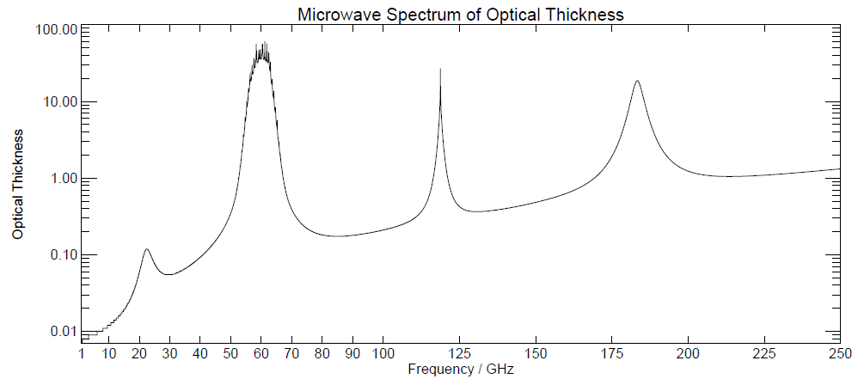
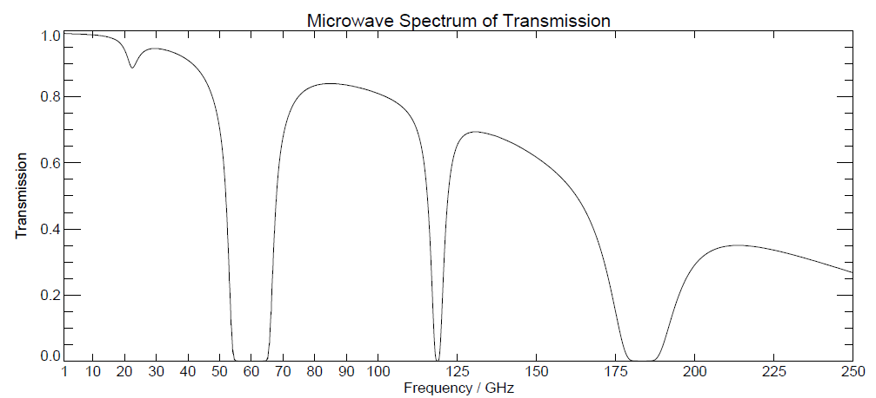
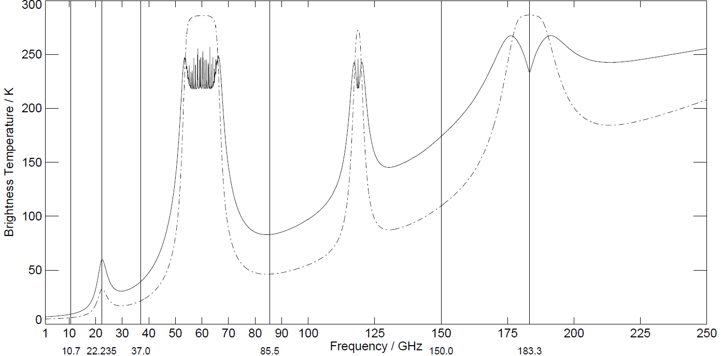
Different views of the MW Spectrum
H2O 22.235
Oxygen 118
H2O 183.31
Window 18.7
Oxygen 60
Window 36.5
Window 150
Window 225
Window 90
Optical thickness (0 … 100, or more)
Transmission (0 … 1)
Brightness Temperature TB (2.7 … 300)

Slide 11
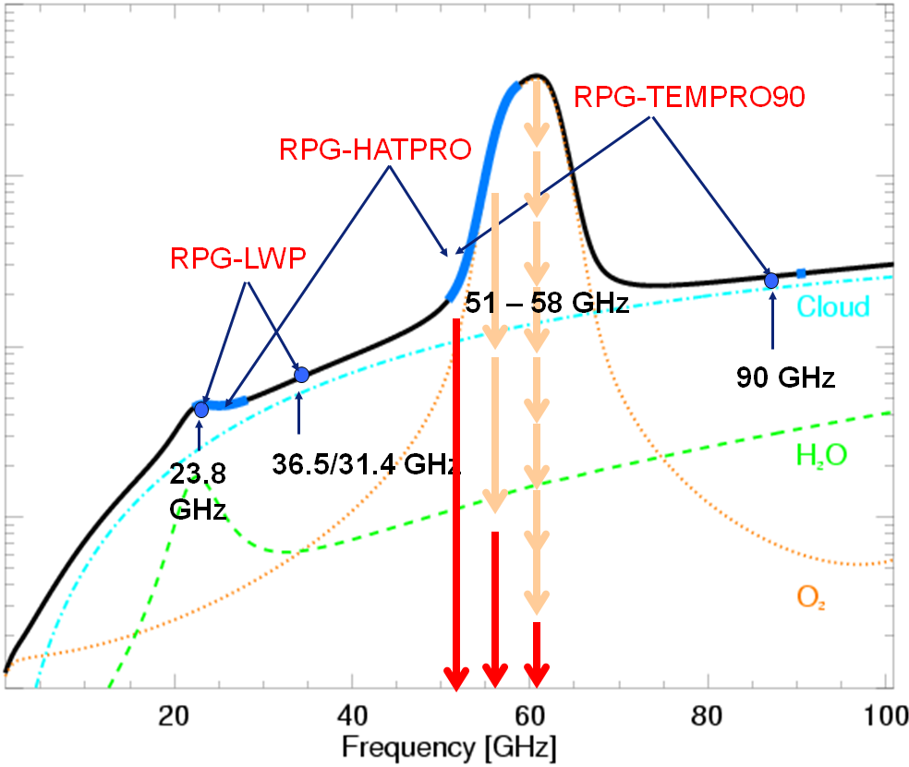
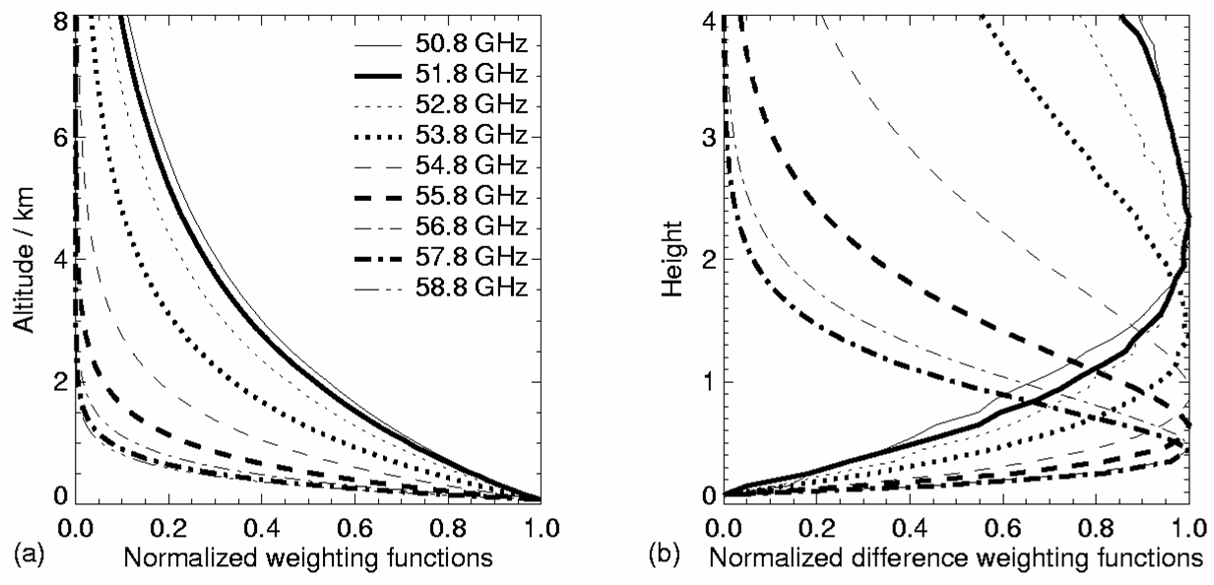
Source of Information: Basic Concepts (I)
LWP/IWV:
Compare a channel in the H2O line with a window channel
Increase in H20 increases TB in line, not in the window
Increase in LWP adds to both channels, (most in the window)
T-Profile:
Frequency dependent absorption depth
Contributions from upper atmosphere to
total received signal are stronger for low
absorption (absorption on the way down)
Concept of weighting functions…

Slide 12
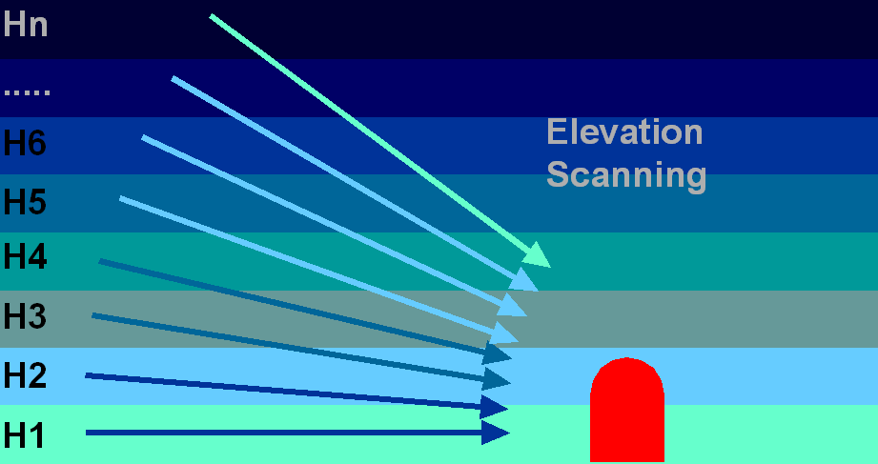
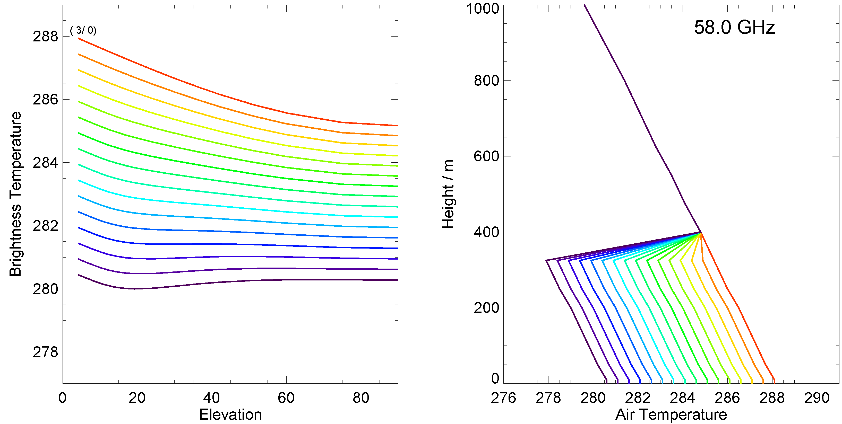
Source of Information: Basic Concepts (II)
Boundary Layer T-Profile:
Absorption length decreases for frequencies at line center (60 GHz)
Limited (approx. 600 m) emission depth @ 58 GHz
Weighting functions shifted towards surface by elevation scans
2.5 K signal
1.0 K signal

Slide 13
Navigation
Done so far:
the source of the radiation, and
the way the atmospheric conditions make an imprint on the microwave spectrum…
Remaining:
Have a measurement device for microwave radiation
Transform microwave measurements into atmospheric data
4. Radiometers: Hardware

Slide 14
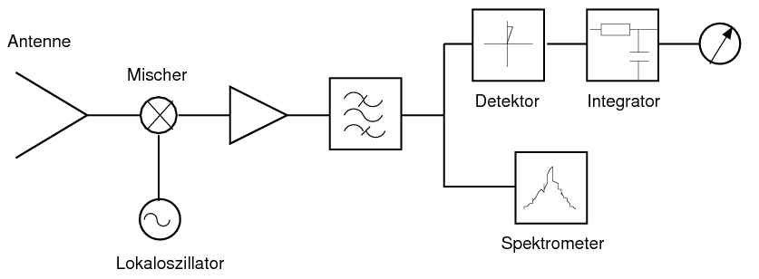
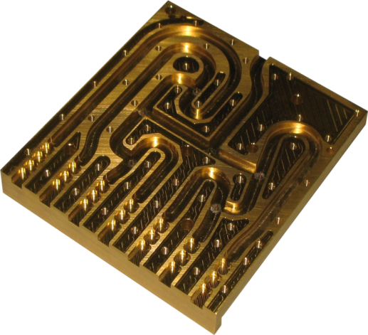
Radiometer Technology (I): Layout
Select frequencies for variables of interest (+ NE∆T, bandwidth, …)
Select a receiver technology
  Direct-Detection Filterbank: Amplify, split, filter, detect
  Heterodyene: down-conversion to IF, the process the IF, or
  sequentially scan the LO over scpterum (slow, RFI problems)
Select calibration mechanisms
Engineer a robust infrastructure around the RF

Slide 15
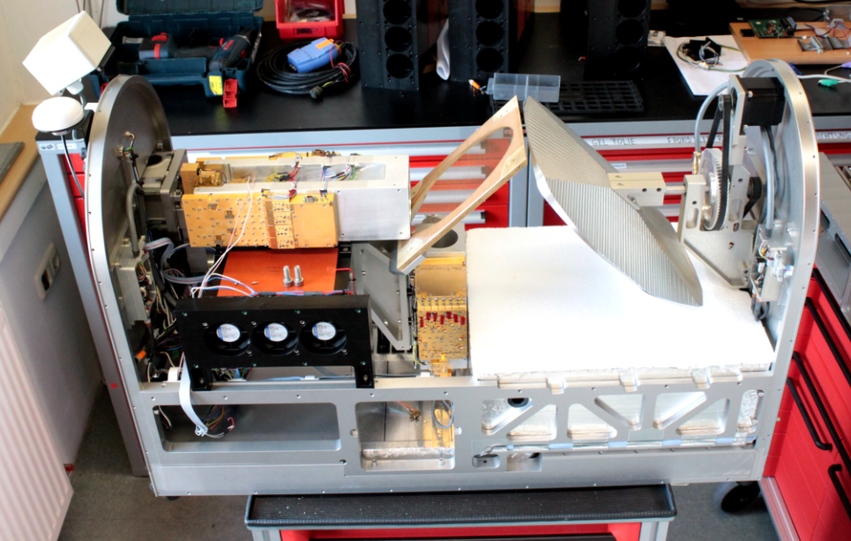
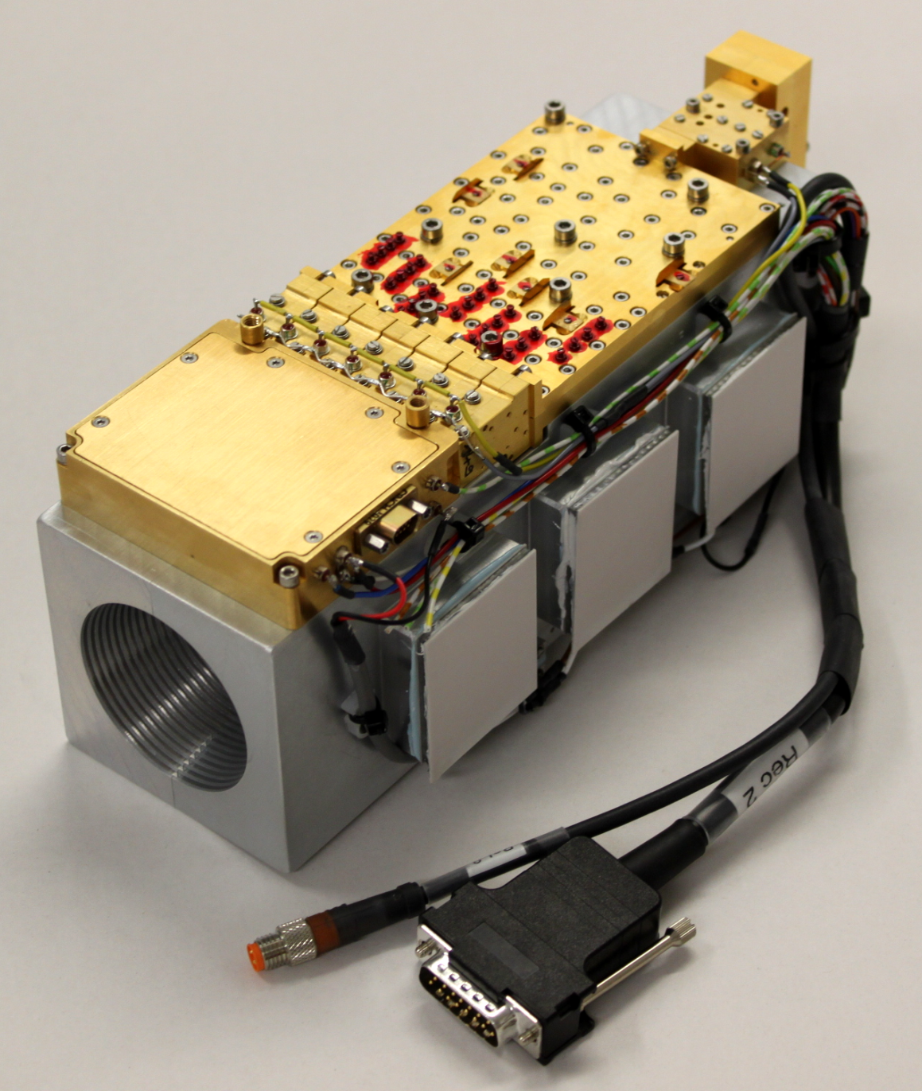

Hardware Example
HATPRO Direct Detection Filterbank Profiler
(parallel data aquisition 14 ch.)
7-channel
V-Band
Receiver

Slide 16
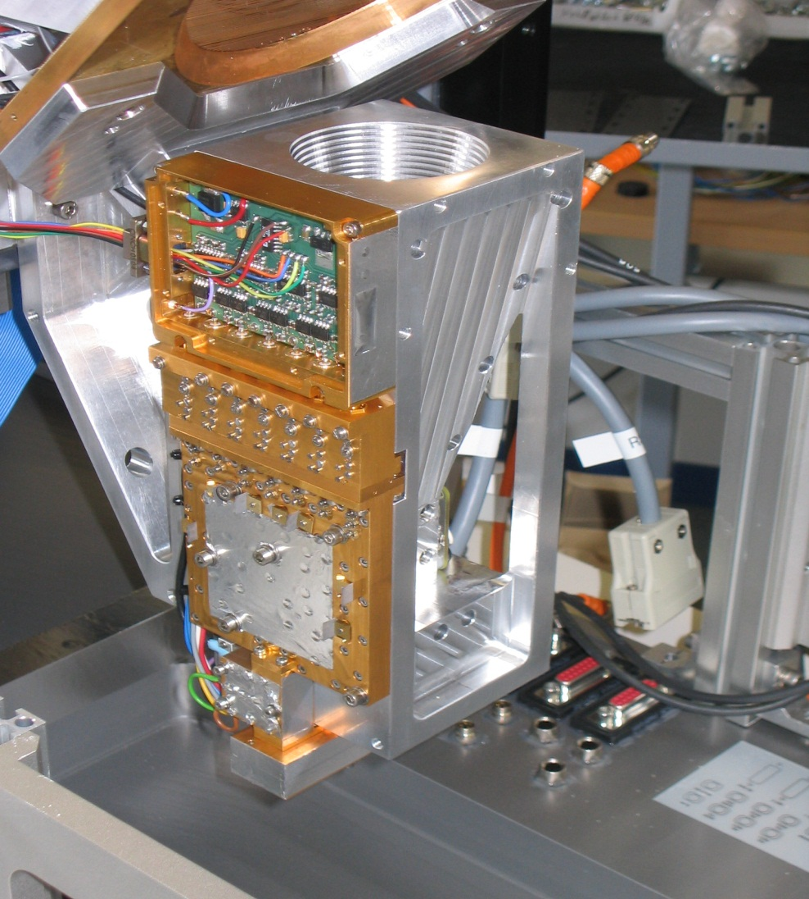
Frequencies, bandwith and # of channels
 | K Band (22- 31) | V Band (50-60)
Channel 1 | 22.24 GHz / 200 MHz | 51.26 GHz / 230 MHz
Channel 2 | 23.04 GHz / 200 MHz | 52.28 GHz / 230 MHz
Channel 3 | 23.84 GHz / 200 MHz | 53.86 GHz / 230 MHz
Channel 4 | 25.44 GHz / 200 MHz | 54.94 GHz / 230 MHz
Channel 5 | 26.24 GHz / 200 MHz | 56.66 GHz / 650 MHz
Channel 6 | 27.84 GHz / 200 MHz | 57.30 GHz / 1000 MHz
Channel 7 | 31.40 GHz / 200 MHz | 58.00 GHz / 2000 MHz
Tsys | < 350 K | < 600 K
Degrees of Freedom | 2 to max. 3 uncorrelated informations | approx. 5 uncorrelated informations
Auto-Calibration Devices:
Noise Injection + Magnetically switched Isolators
20 Hz Dicke-Switching, ultra-stable, 4000 s Allan-Stability

Slide 17
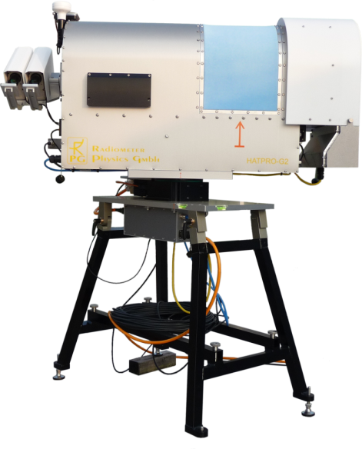
Radiometer Technology (II): Calibration
Detector always „sees“ contributions from
  system emission of lossy components,
  plus scene (atmosphere signal),
  plus additional calibration signals
Voltage signal proportional to second moment of E-field (total power, no phase!)
T_{sys} describes systems sensitivity limits by own emission:
T_{sys}=3000 K, T_{sig}=300 K → SNR=0.1
Gain (mV/K): frequently measure G by comparison of TB with black body
(quasi-optical load or waveguide termination)
Initial 4-point Calibration:
Cold load
Cold load + noise diode
Ambient load
Ambient load + noise diode
4 Equations for 4 unknowns
Derive G, T_{sys}, T_{n}, α
Detector Voltage
Sum of thermal noise power

Slide 18
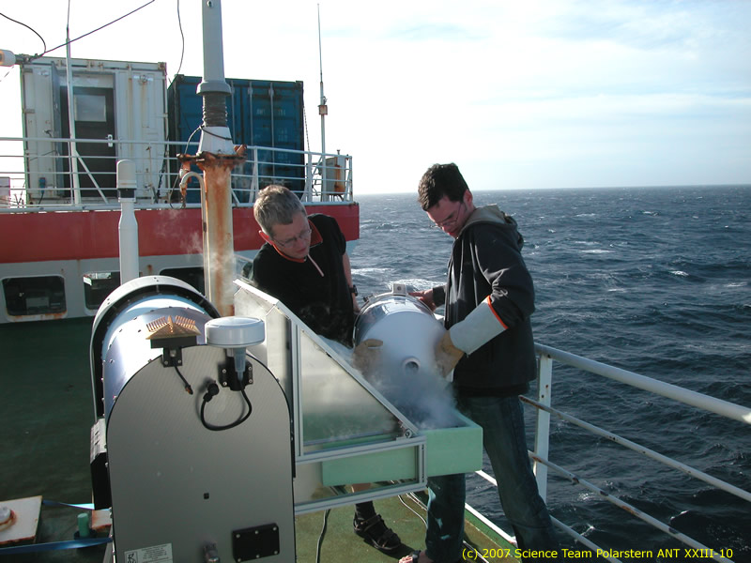
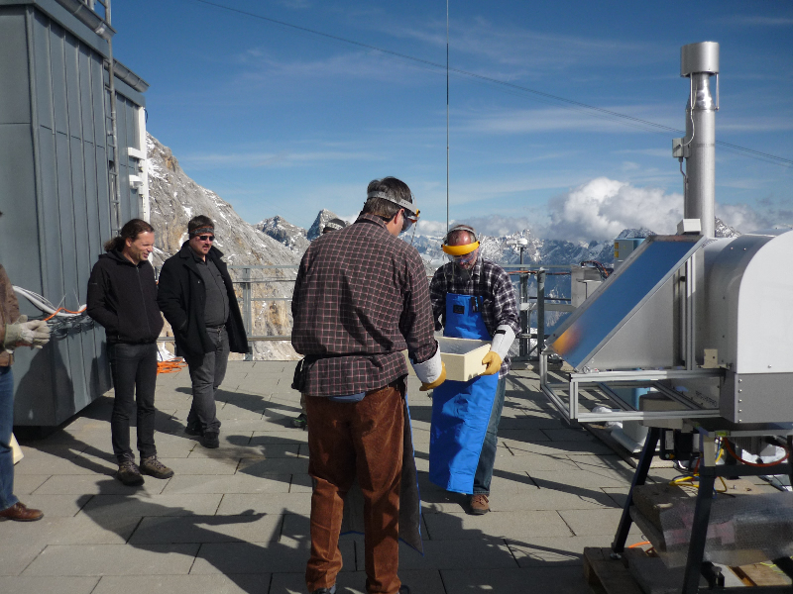
Radiometer Technology (III): Calibration examples

Slide 19
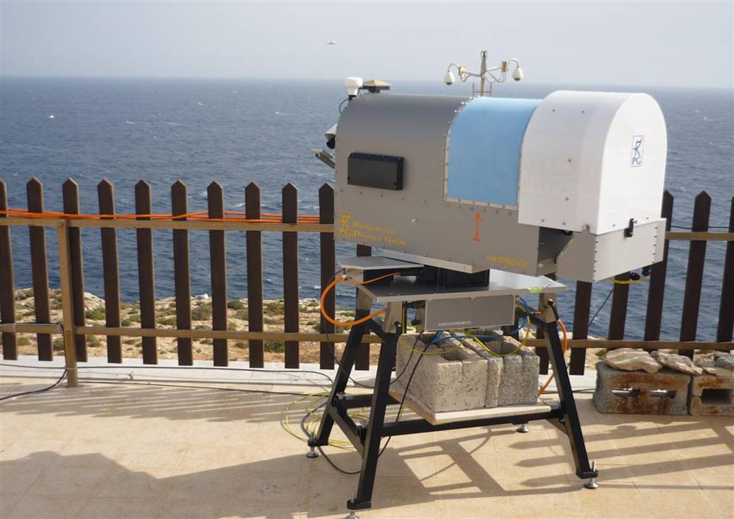
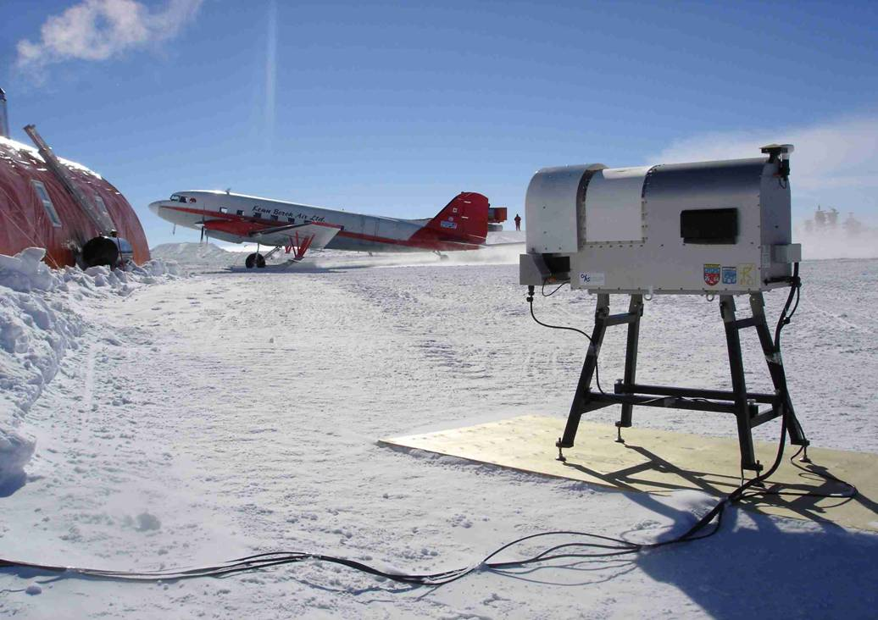
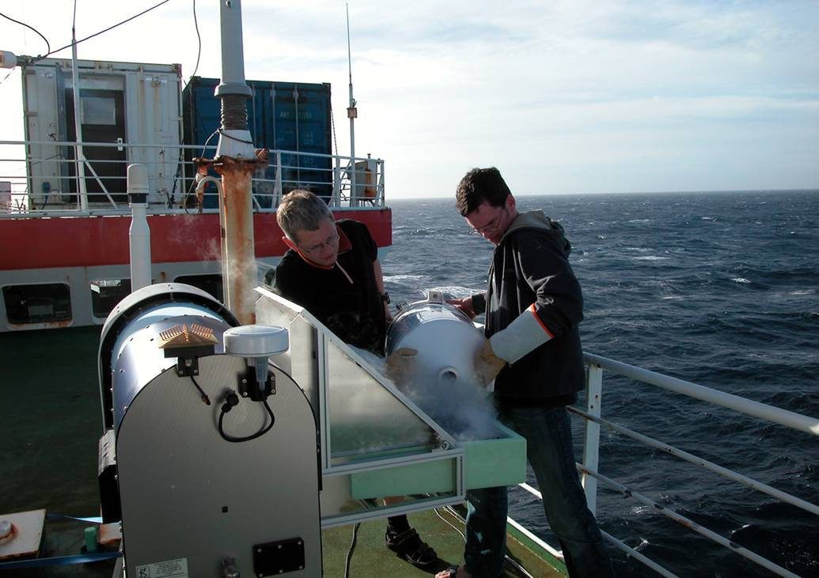
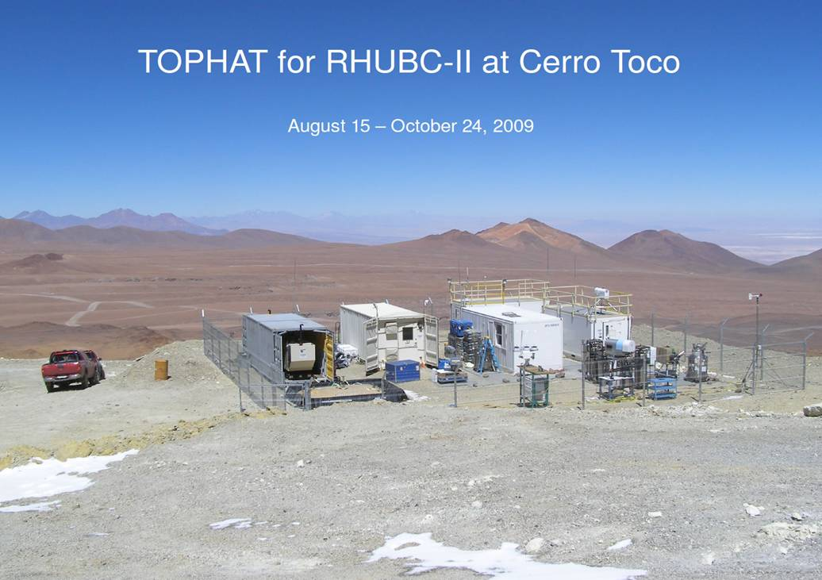
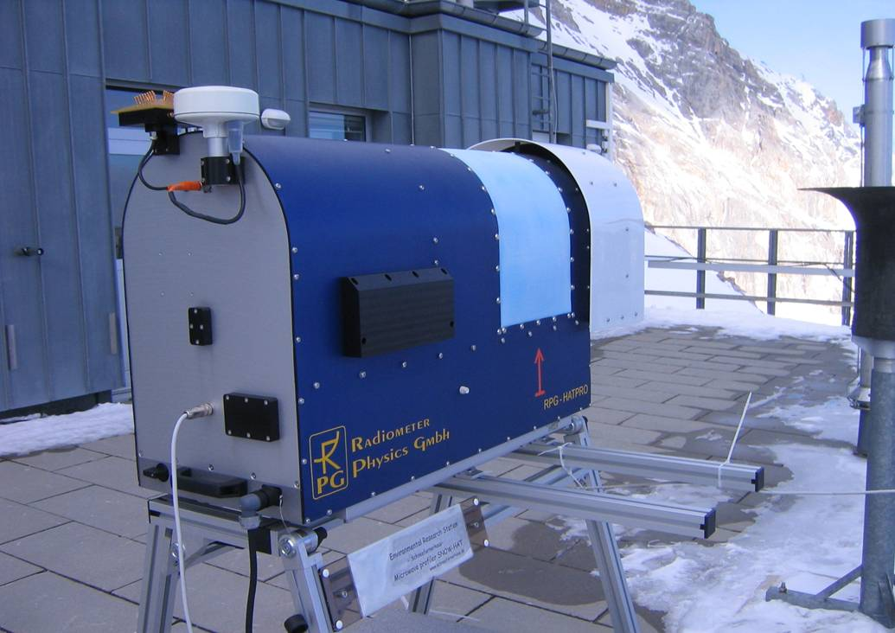
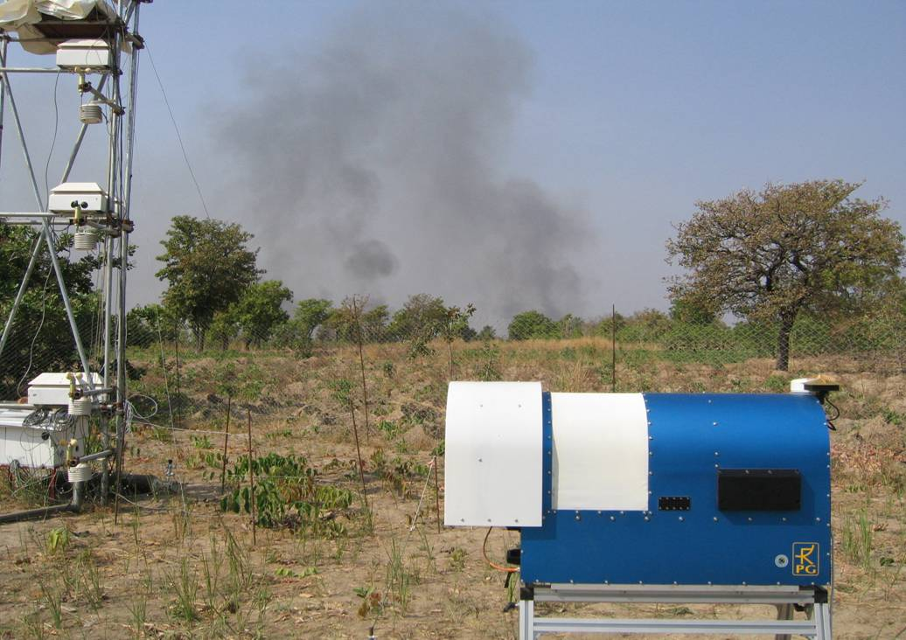
Challenge: Environment Conditions
Lampedusa, Italy
(humid, hot, salty)
Dome-C, Antarctica
(3.300m, -25 to -80 °C)
Research Vessel “Polarstern”
(Atlantic Ocean)
ALMA site, Chile
(5.500m above sea level)
Zugspitze, Germany
(2.800m, -35 °C, 250km/h wind)
AMMA campaign, Benin
(West-Africa, hot climate, dust)

Slide 20
Navigation
5. How to Retrieve Meteorological Data from TB data

Slide 21
Retrievals
Solving the „forward problem“
(radiative transfer for a given
atmosphere)
  TB = F(T(z), Q(z), P(z), LWC(z))
Inversion of F is the „retrieval“, e.g.:
  T(z) = F⁻¹(TB)
Inversion problem is ill-posed
Data set statistics important!
Representative Profile Data Base (RS)
Cloud model (~ 95 % threshold)
atmospheric profiles:
p(z), T(z), q(z), LWC(z)
Training
Test
Integration
RT model
RT model
Integration
LWP, IWV
TB(ν)
TB(ν)
LWP, IWV
Statistisches Modell
mult. Regression, NN
Algorithm
Comparison
Radiative Transfer Model simulates the instrument response to each atmospheric state („Forward Model“)
Different choices for inversion scheme:
  Regression retrievals derived by fitting mathematical function to explain atmospheric variables as a function of the TB-vector
  Iterative („physical“) retrievals start with a first guess state and iteratively modify the profile to minimize the TB difference between simulated and mesured TB
  ➔ 1D-Var, 4D-Var

Slide 22
Building and Testing of a Statistical Retrieval
Task: Find equation that links IWV to brightness temperatures (TB):
IWV = a0 + a1*TB1 + a2*TB2 + a3*TB3 + …
(IWV = a0 + a1*TB1 + a2*(TB1)² + a3*TB2 + … )
Use 10.000 Radio soundings to
  Calculate/Analyze real IWV from soundings
  Simulate TB1, TB2, TB3, …
Use 5.000 pairs of IWV and corresponding brightness temperature vectors (TB1, TB2, TB3, …) to derive coefficients a0, a1, a2, a3, …
Use remaining 5.000 pairs of real IWV and simulated TB to test the retrieval:
  For each set of simulated brightness temperatures, apply coefficients a0,a1,a2,..
  to calculate (=retrieve) a simulated IWV (not real TB measurements, but simulated TB measurements used during retrieval)
  Compare “real IWV” to “simulated IWV” from application of retrieval
  For 5.000 cases, we have a difference of real IWV and retrieved IWV
  (and can calculate corellation, RMS, Bias)
  Real IWV is integral of RH-profile
  Simulated IWV is retrieved from simulated TB-vector, which is depending on the full atmospheric condition (different cloud situations, different T-profiles, etc…)

Slide 23
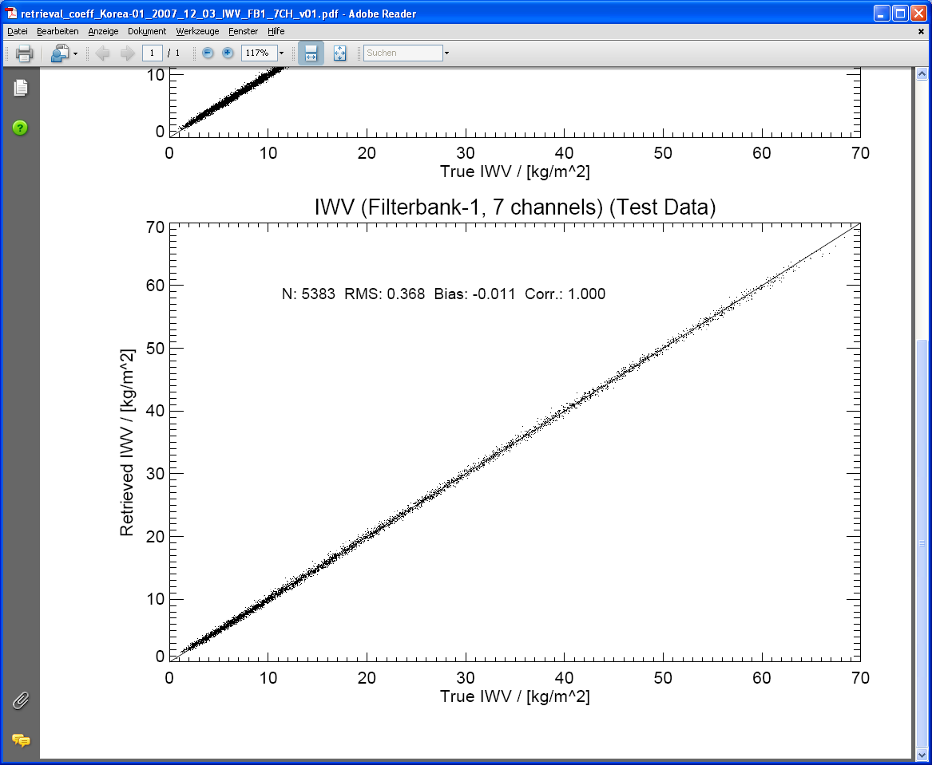
Retrieval Test
Retrieval self test estimates expected performance in terms of RMS

Slide 24
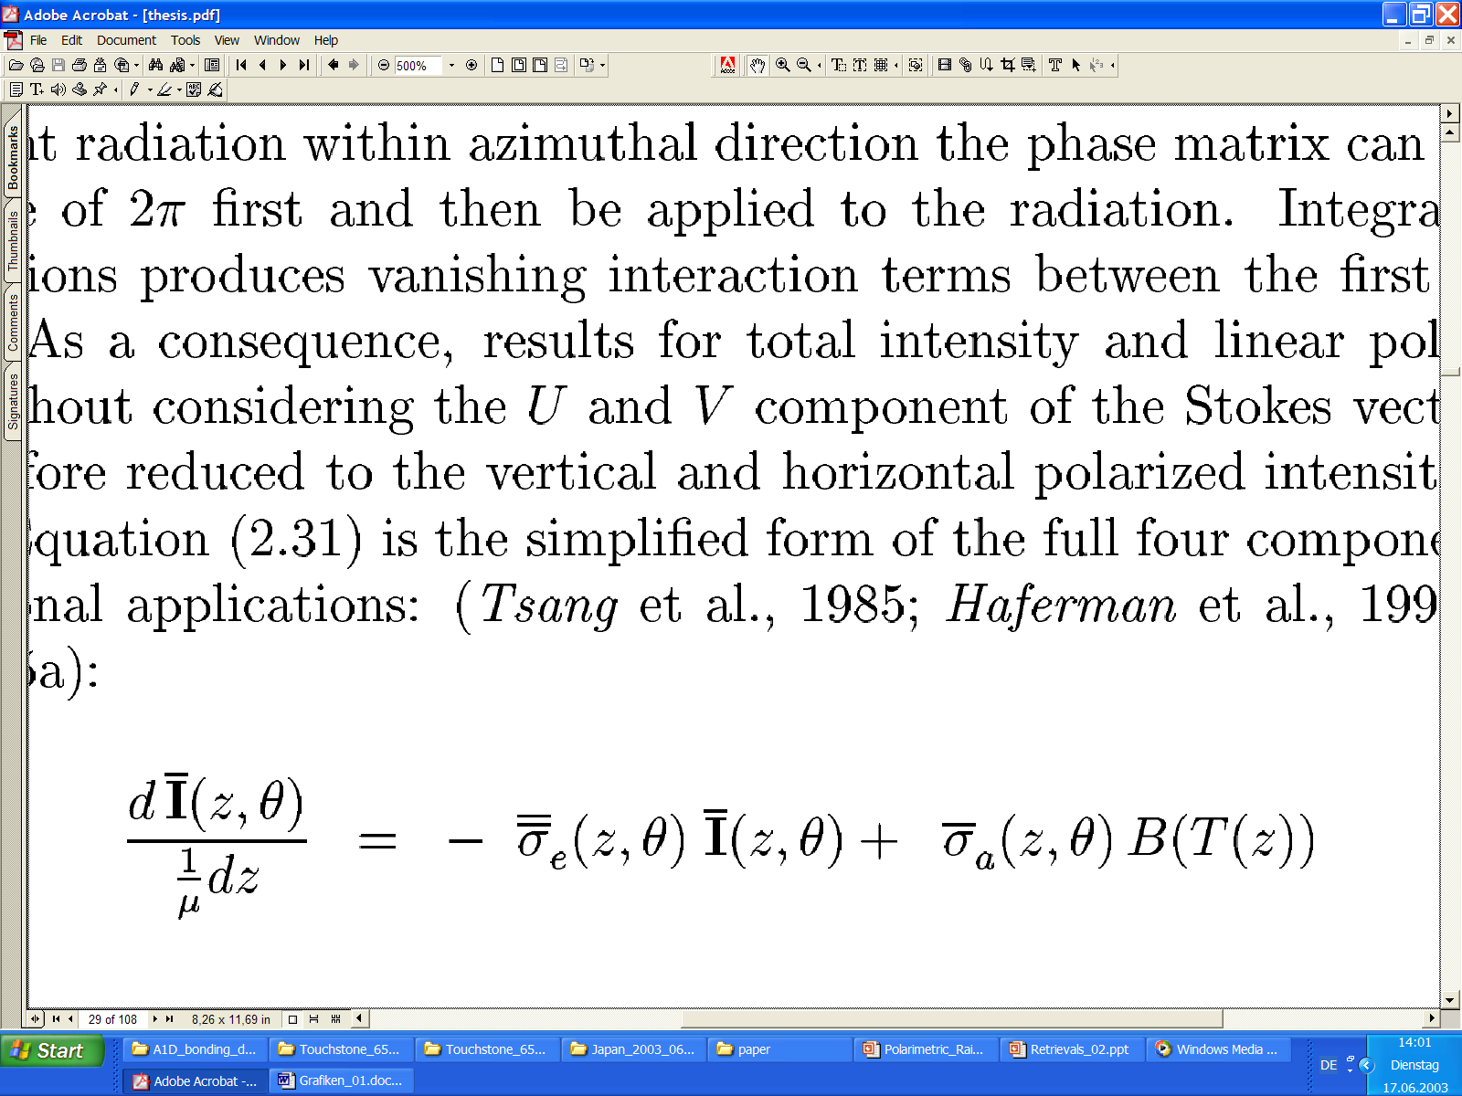
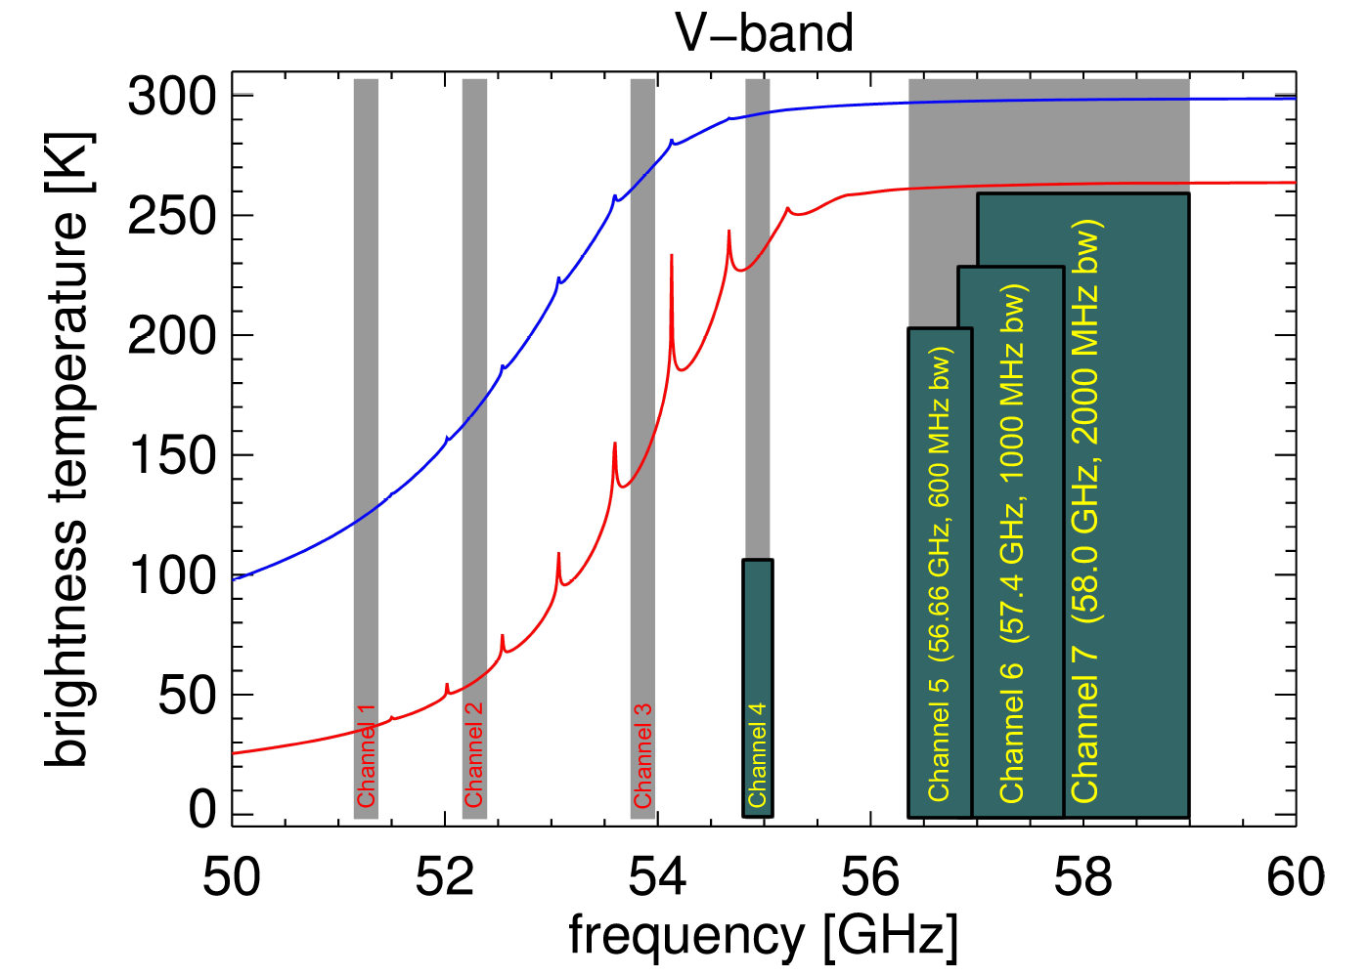
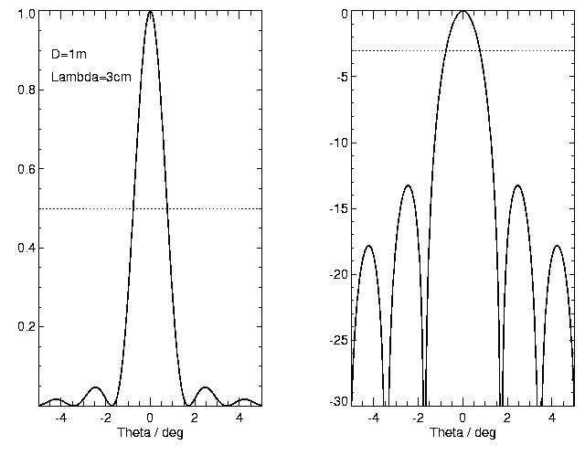
RTM Model
RT model solves 1D or 3D radiative transfer equation
Simple emission/absorption models
Sophisticated (multiple) scattering codes
Polarization (surface effects, non-spherical hydrometeors)
Before retrieval building:
Last processing layer needs to model the imperfections of the radiometer system, such as
  RMS noise
  Calibration uncertainties
  Band width effects (no such thing as a centre frequency!)
  Beam width (antenna patterns usually 1 to 10 degree)
  Earth curvature (transparent channels)

Slide 25
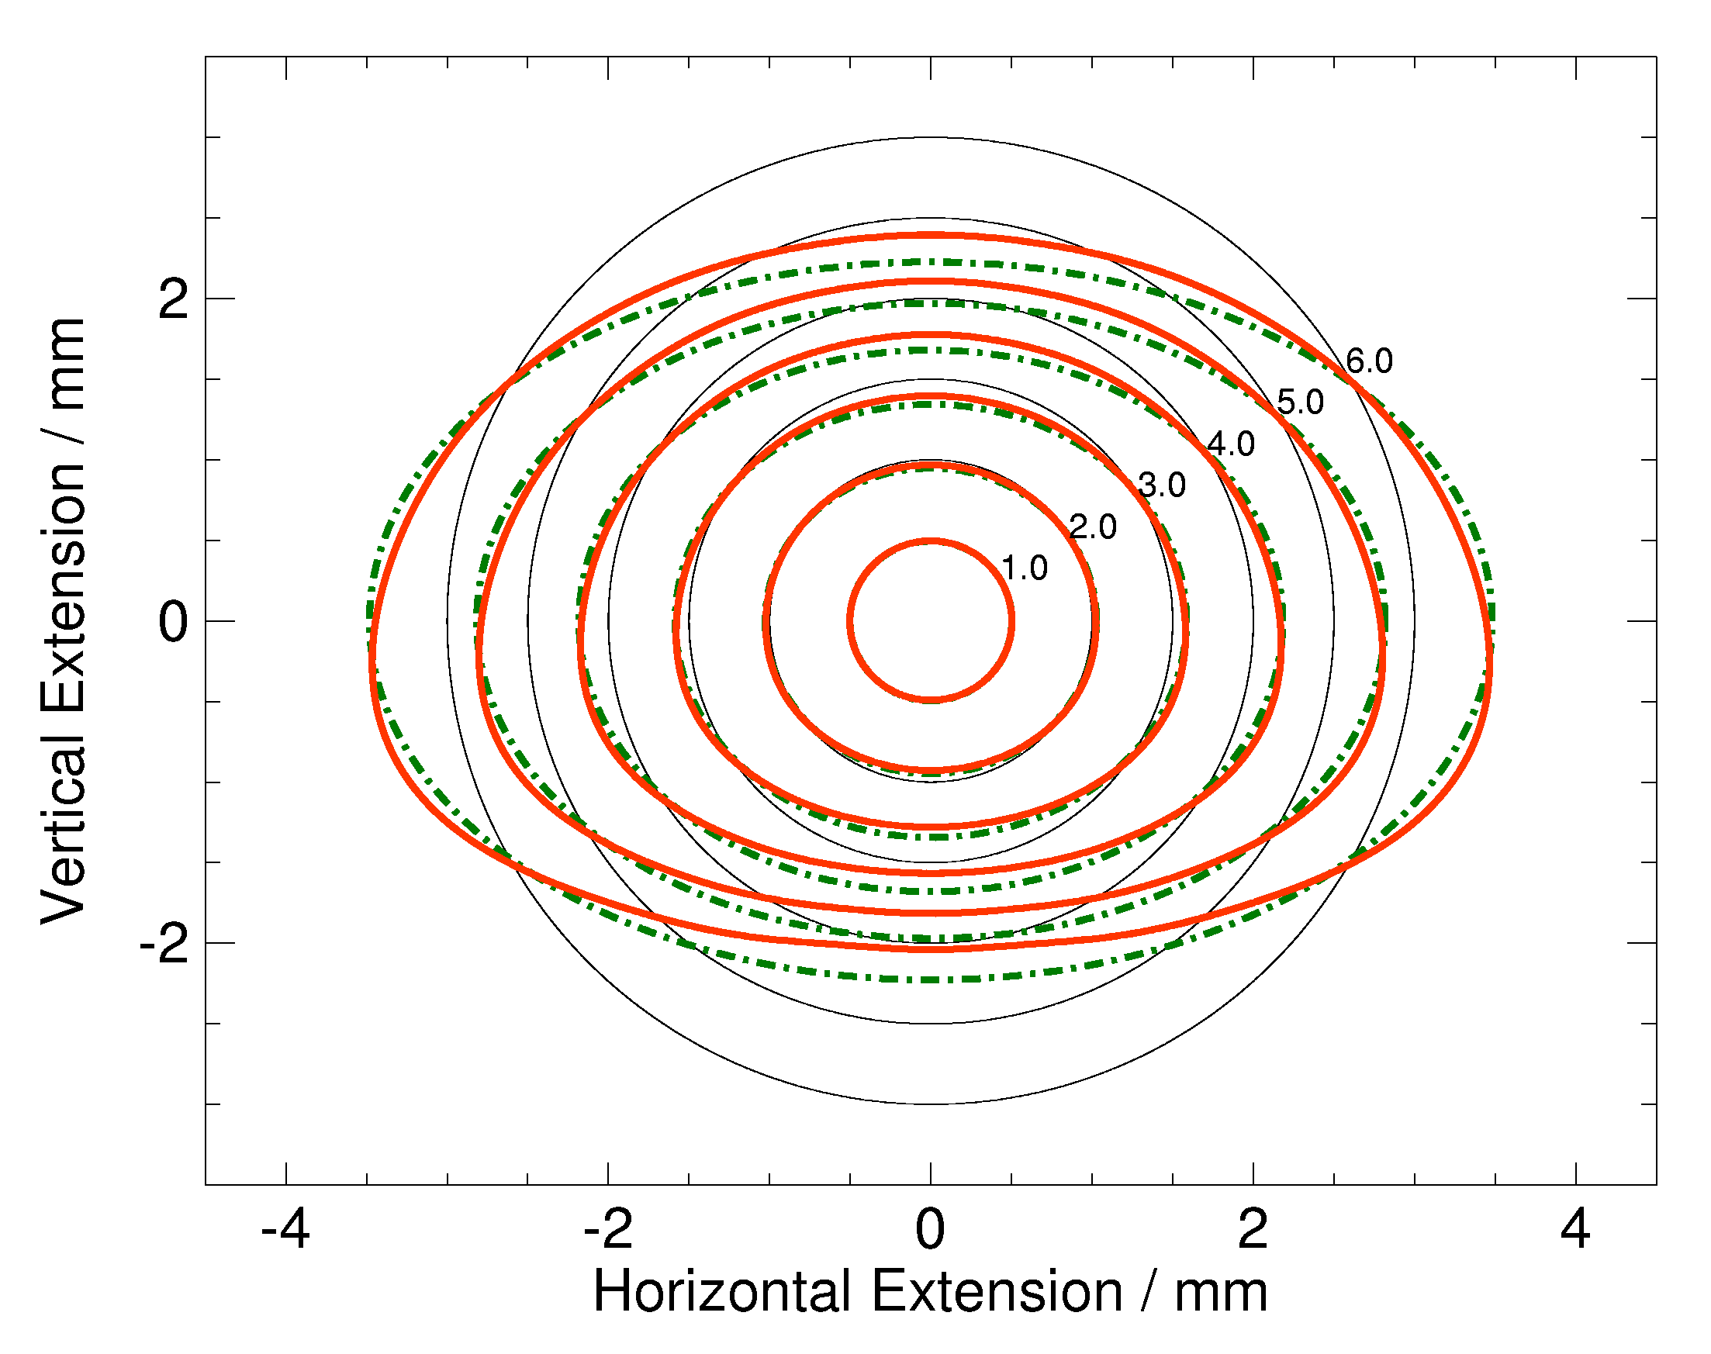
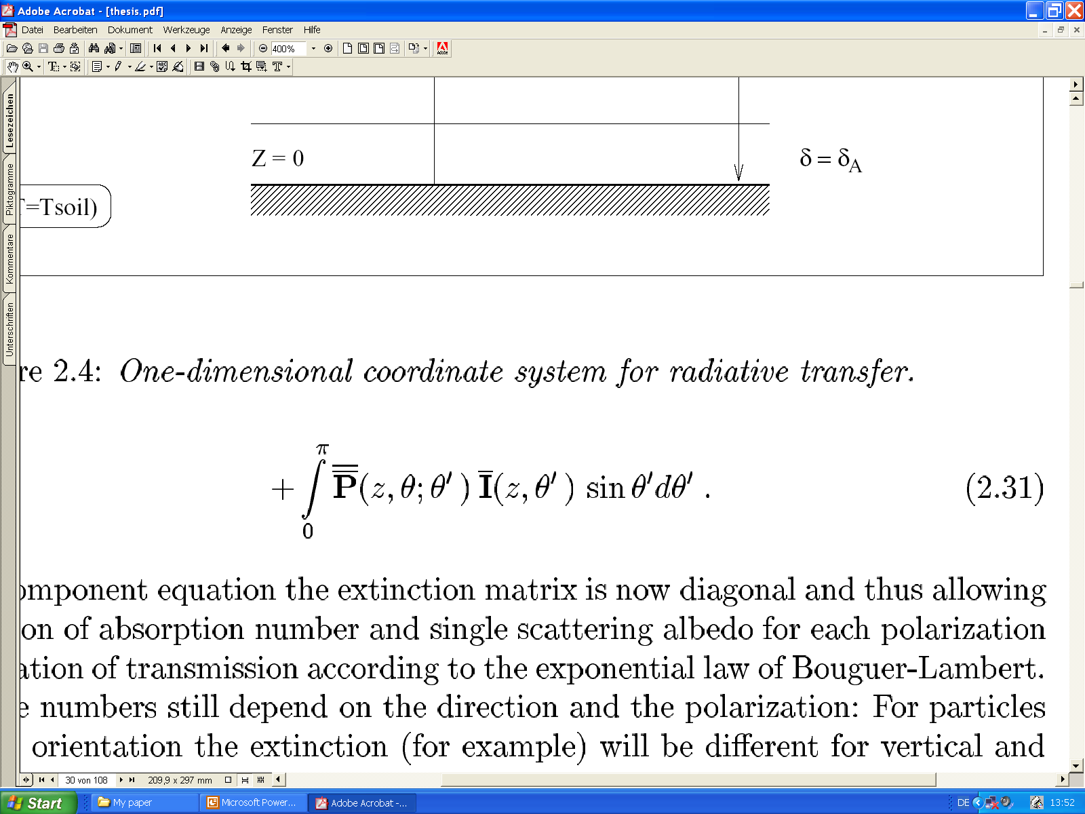
RTM Model (continued)
Simplified (non-scattering) RT model
only good for non raining atmospheres
Scattering more important at higher frequencies
At low frequencies: Polarization effects by emission
of non-spherical particles (rain at 10 GHz)
Extension for rain or snow (graupel, ice, …):
  Polarized RTE using the 4-component Stokes vector
  4 coupled Integro-Differential equations
  (with boundary conditions)
Differential change
Scattering source (phase function)
Emission source
Extinction loss
(absorption + scattering)

Slide 26
Navigation
6. Data Examples

Slide 27
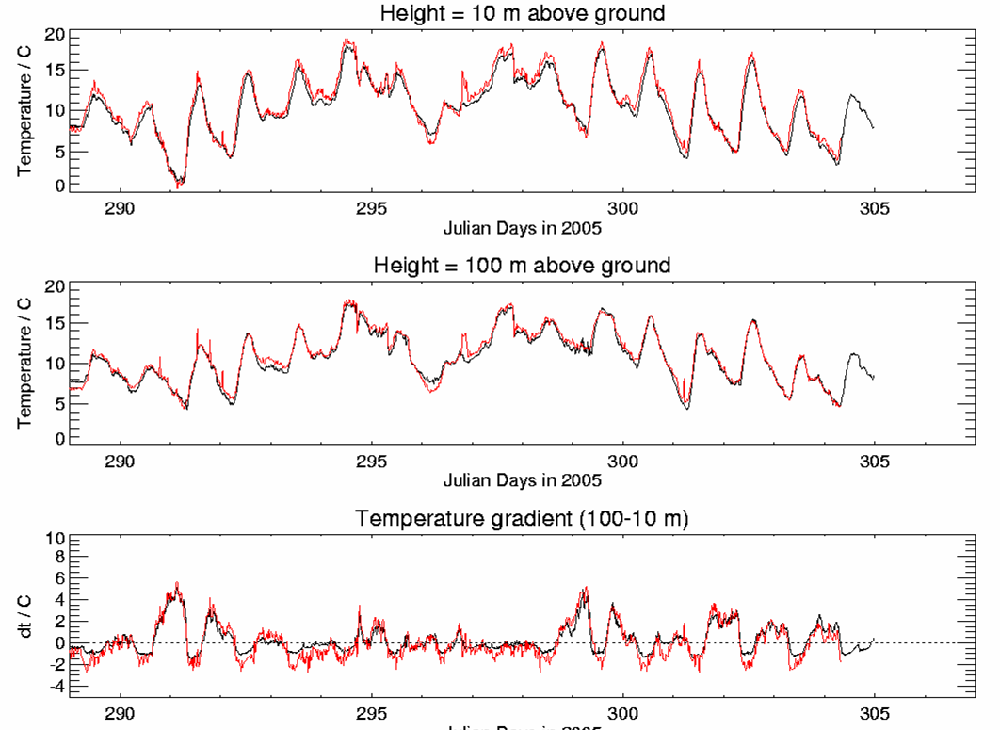
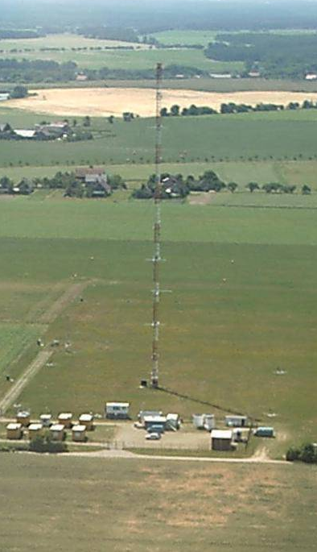
Comparison with Mast data: 15 day time series
10 m temperature:
Black: mast, red: MWR
100 m temperature:
Black: mast, red: MWR
Temp. Gradient: show
lapse rate vs. inversions
Courtesy of Susanne Crewell, University of Cologne, Germany

Slide 28
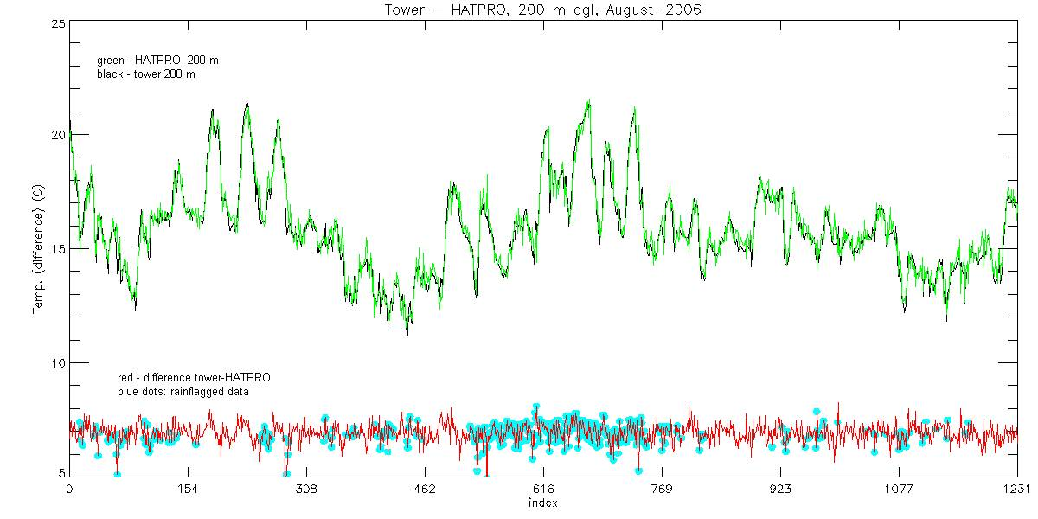
Measurements: 200m temperature at KNMI mast
Comparison of HATPRO 200m temperature measurements with tower at 200m
RPG-Boundary-Layer-Mode: elevation scans, optimized bandpass filters, small beam
Red: difference (HATPRO – tower) (shifted to +7 K for visibility)
Blue: Rain flagged data, but no quality difference!
Courtesy of Henk Klein-Baltink, KNMI, Neatherlands

Slide 29
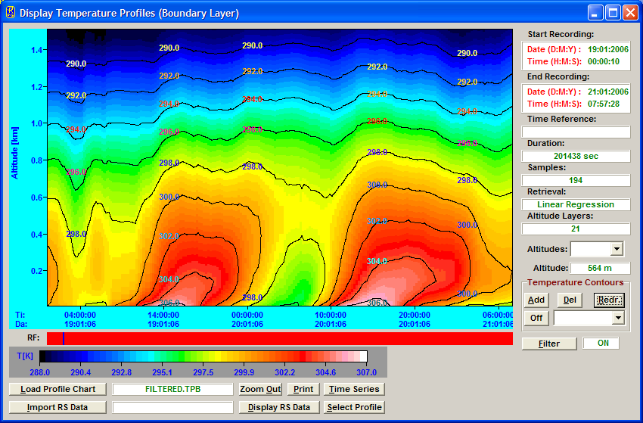
Boundary Layer temperature profile

Slide 30
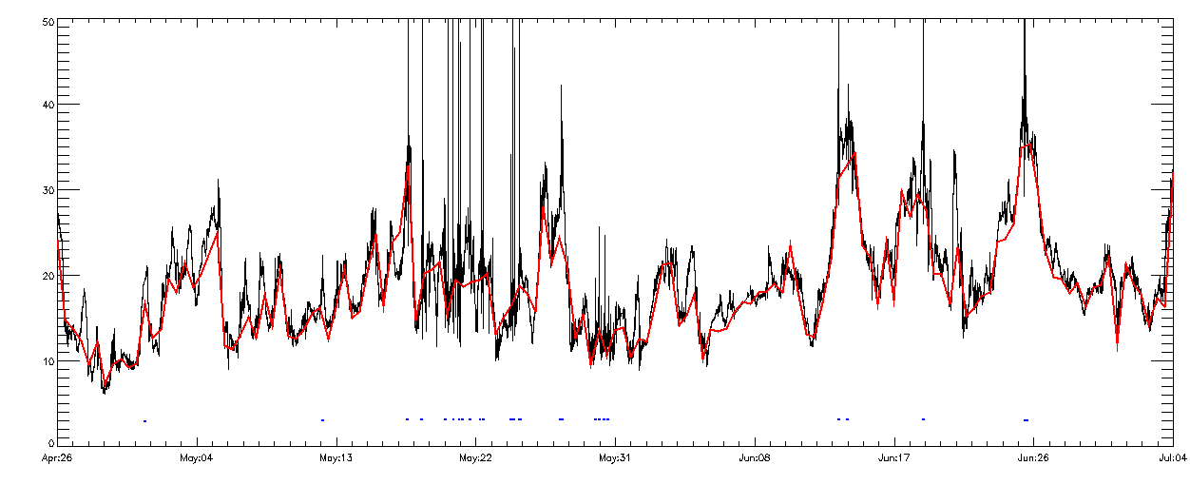
IWV at Cabauw, KNMI
IWV time series over one month (KNMI, May 2006).
140 radio soundings (26. April to 4. July, Cabauw, KNMI).
Radiosonds: Vaisala RS-92.
No-Rain RMS: 0.43 kg/m^2, Bias: 0.05 kg/m^2

Slide 31
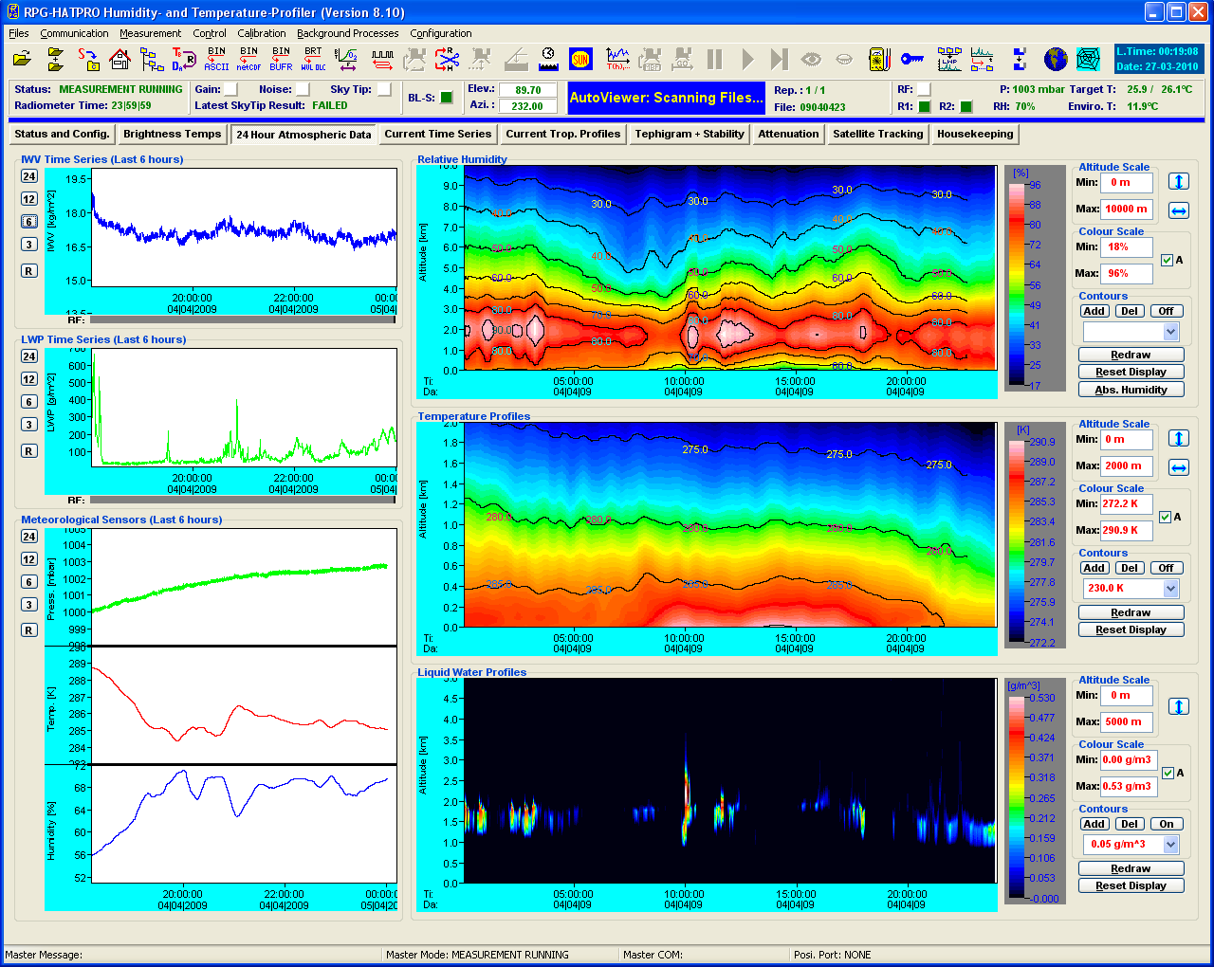
Software – 24-hour readings of OWV, LWP, Cloud, Met-sensors

Slide 32
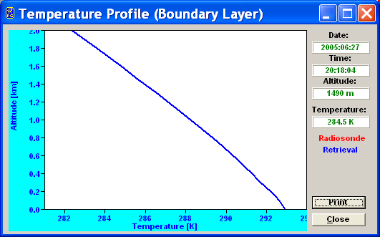
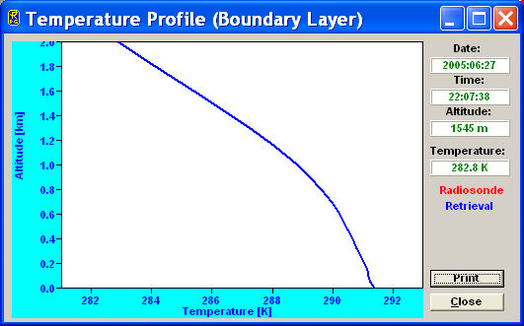
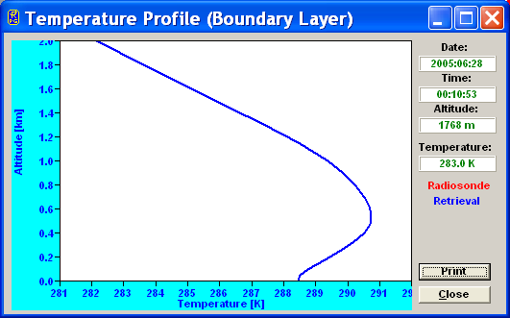
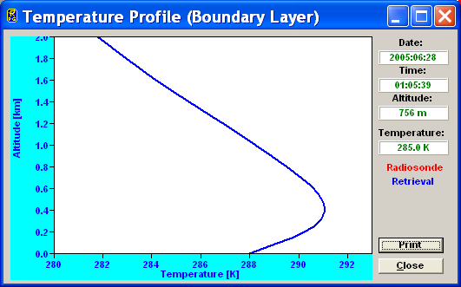
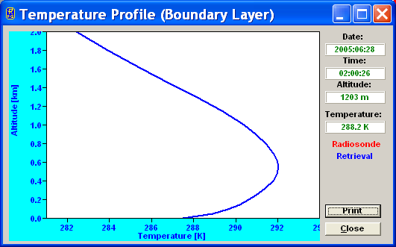
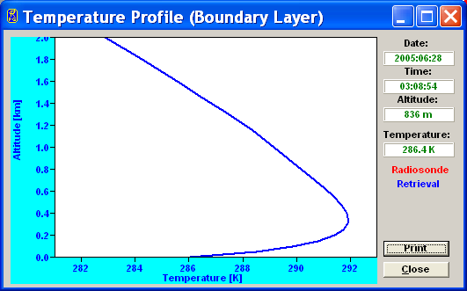
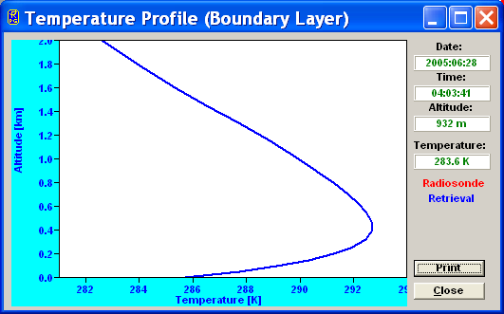
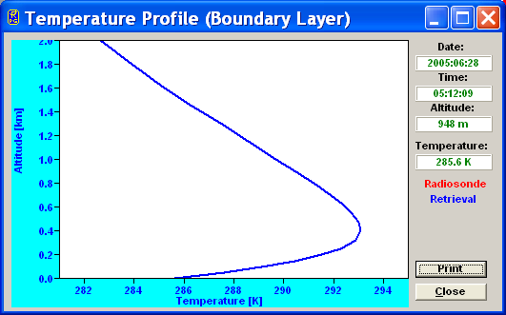
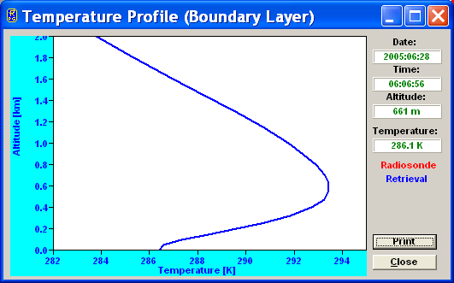
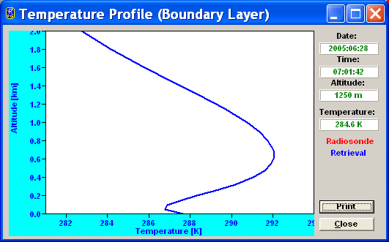






Time series of temperature inversion

Slide 33
Thank you!
czekala@radiometer-physics.de

